Slide 1

DATA SCIENCE
REAL-ESTATE LISTING
Ivan Alejandro Hernandez Aguirre
ivanhdezaguirre@gmail.com
226 - 344- 5876

Slide 2
ABOUT MYSELF
I have been living in Canada for the last 7 years.
I have a Bachelor's Degree on Mechatronics Engineering.
I have been doing Controls Engineering for the last 7 years for the automotive industry.
I like outdoors activities and I enjoy winter hiking a lot.
I like dogs , rock music and I Am fluent in Spanish and English.

Slide 3
PROBLEM STATEMENT
What do we need to solve?
WHY IS A PROBLEM?
Search Engine Ranking Decreases
Risk of becoming a scammer hotbed
User Experience and Behavior gets complicated
GOAL OF THE PROJECT
In this project, we have scraped real-estate listings from different providers. We need to apply classification algorithms to identify whether the listings are the same or different.
BUSINESS VALUE
A well - moderated site is the best way to keep scammers away.
Irrelevant content is one of the main reasons turning customers away from classifieds sites.
Trust and reputation.

Slide 4
PROJECT FLOW
What is the approach for this problem?
trainlisting.csv
testlisting.csv
locations.csv
trainMatchedlistings.csv
types.csv
CLEANING AND
ANALYSIS OF CSV FILES
MERGING CSV FILES
INTO A DATAFRAME
Merge together csv files with relevant features.
Perform cleaning on the raw data.
Numeric columns with string values
NLP techniques on description features
Analysis distribution of the data
PROJECT ACTIVITIES
EDA ANALYSIS AND
FEATURE ENGINEERING
SELECT A CLASSIFICATION MODEL
Perform modeling with Random Forest Classifier, Logistic Regression, Naive Bayes etc
TEST ACCURACY OF THE MODEL AND IMPROVEMENTS
Test different techniques to replace nan values for numerical values and outliers.

Slide 5

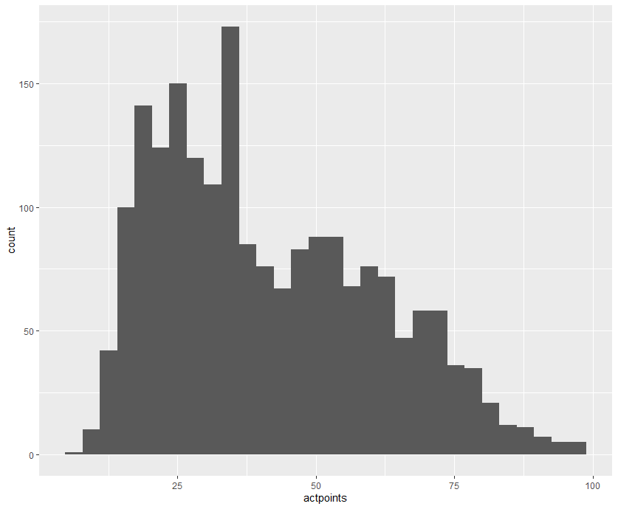

KEY ELEMENTS ON FEATURE ENGINEERING
DEALING WITH RAW DATA
DISTRIBUTION OF THE DATA
TECHNIQUES TO FEATURE OUR DATA
Removing unnecessary data
Removing rows with string data
in numeric columns
Transform object columns to
numeric columns
Check skewness of the features
Data had several outliers and had right skewness
Multiple empty values in all the features.
Log transformation
Square Root transformation
Replace nan values with the median
Remove those features with more than 60 percent of missing data
Apply median after log transformation
Remove old columns which data is not normalize

Slide 6
MOST RELEVANT FEATURES
LOCATION ID
TYPE ID
PRICE
BEDROOMS
BATHROOMS
TOTAL AREA
LIVING AREA
PLOT AREA
DESCRIPTION APPLYING NLP TECHNIQUES
SOURCE ID
ID

Slide 7

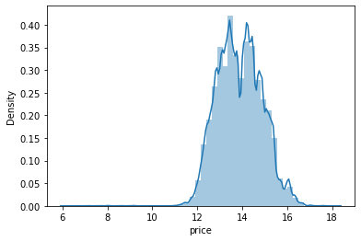
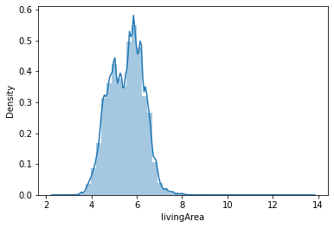
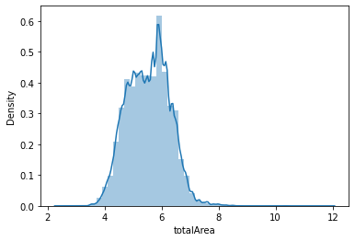
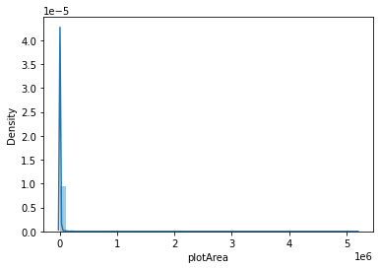
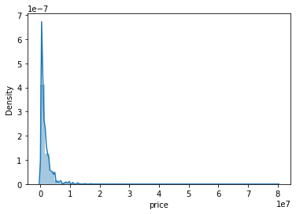
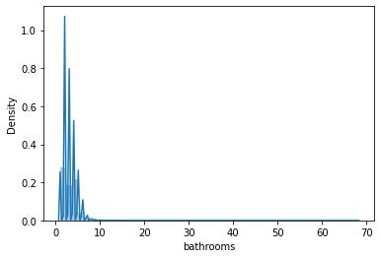
DATA VISUALIZATION

Slide 8
CONCLUSIONS
Due the nature of the data , Random Forest Classifier was the best option to train the model, with an accuracy of .83 and F - Score of .600
Logistic Regression and Naive Bayes models got an accuracy of .77 and .76
It was very interesting to notice that most of the list items that were repeated have a similar price and number of rooms, however sometimes the description didn't have similar words at all.
Latitude and longitude were missing at a 70 percent rate despite the nature of the problem.
It seems most of the realtors that fill the data focus on the size of the property area , number of rooms overall, brief description of the place and the type of property (apartment,investment).
I will conclude that this project it is based on a real scenario in the property market.

